Slide 1
EEE 342/ETE418
Control Engineering
Fall 2019
Lecture # 03
2 October 2019

Slide 2
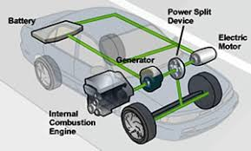
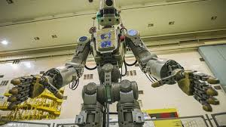
Components of system
Some components are electrical
Some components are mechanical

Slide 3
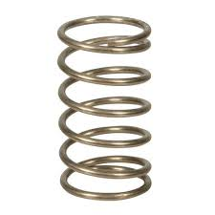
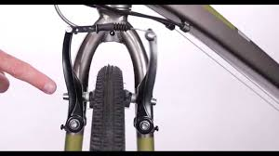
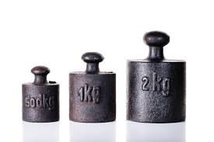
Mechanical components

Slide 4
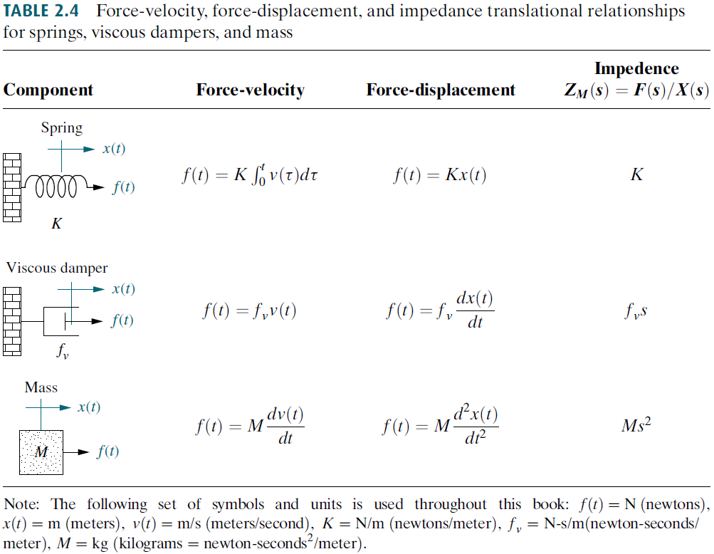
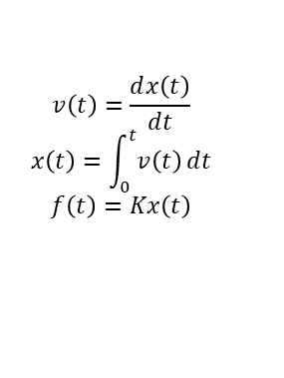


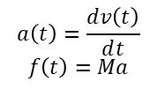
Translational Mechanical System Transfer Functions
$$v\left(t\right)=\frac{ⅆx\left(t\right)}{ⅆt}$$
$$x\left(t\right)=\int_{0}^{t}{v\left(t\right)ⅆt}$$
$$f\left(t\right)=Kx\left(t\right)$$
$$Dv\left(t\right)$$
$$D$$
$$a\left(t\right)=\frac{ⅆv\left(t\right)}{ⅆt}$$
$$f\left(t\right)=Ma$$

Slide 5
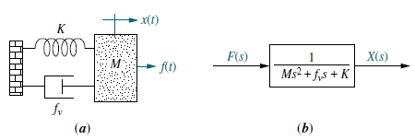
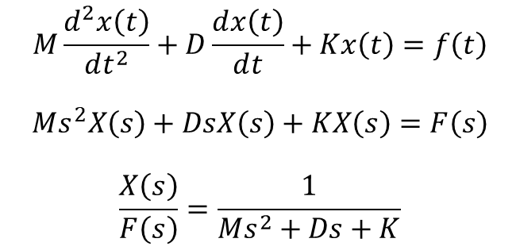
Example 2.16
$$M\frac{ⅆ^{2}x\left(t\right)}{ⅆt^{2}}+D\frac{ⅆx\left(t\right)}{ⅆt}+Kx\left(t\right)=f\left(t\right)$$
$$Ms^{2}X\left(s\right)+DsX\left(s\right)+KX\left(s\right)=F\left(s\right)$$
$$\frac{X\left(s\right)}{F\left(s\right)}=\frac{1}{Ms^{2}+Ds+K}$$

Slide 6
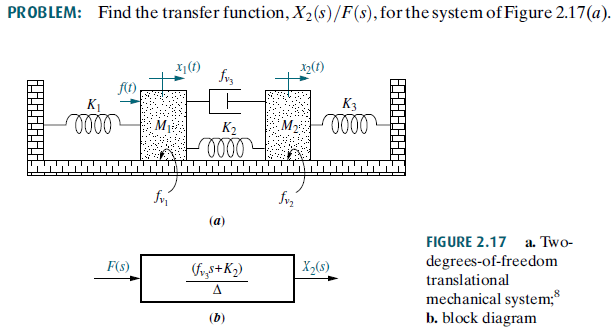
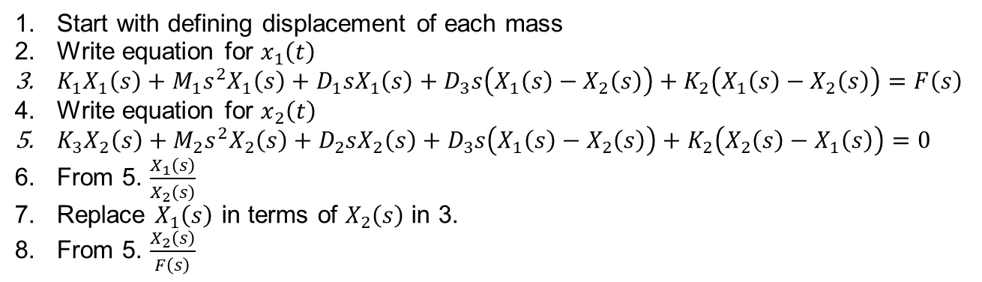
Example 2.17
Start with defining displacement of each mass
Write equation for $x_{1}\left(t\right)$
$K_{1}X_{1}\left(s\right)+M_{1}s^{2}X_{1}\left(s\right)+D_{1}sX_{1}\left(s\right)+D_{3}s\left(X_{1}\left(s\right)−X_{2}\left(s\right)\right)+K_{2}\left(X_{1}\left(s\right)−X_{2}\left(s\right)\right)=F\left(s\right)$
Write equation for $x_{2}\left(t\right)$
${K_{3}X_{2}\left(s\right)+M}_{2}s^{2}X_{2}\left(s\right)+D_{2}sX_{2}\left(s\right)+{D_{3}s\left(X_{1}\left(s\right)−X_{2}\left(s\right)\right)+K}_{2}\left(X_{2}\left(s\right)−X_{1}\left(s\right)\right)=0$
From 5. $\frac{X_{1}\left(s\right)}{X_{2}\left(s\right)}$
Replace $X_{1}\left(s\right)$ in terms of $X_{2}\left(s\right)$ in 3.
From 5. $\frac{X_{2}\left(s\right)}{F\left(s\right)}$

Slide 7
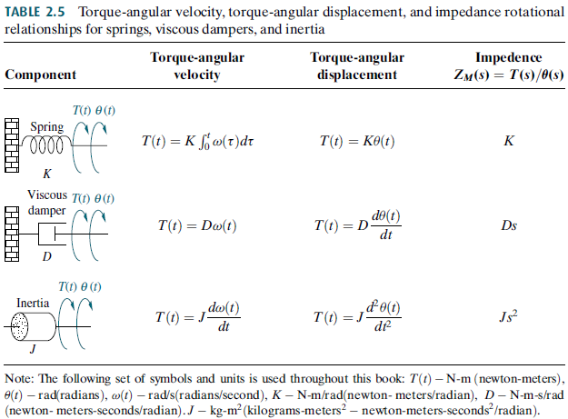
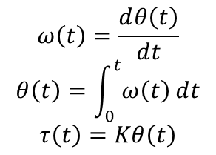
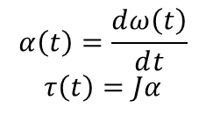
Translational Mechanical System Transfer Functions
$$ω\left(t\right)=\frac{ⅆθ\left(t\right)}{ⅆt}$$
$$θ\left(t\right)=\int_{0}^{t}{ω\left(t\right)ⅆt}$$
$$τ\left(t\right)=Kθ\left(t\right)$$
$$α\left(t\right)=\frac{ⅆω\left(t\right)}{ⅆt}$$
$$τ\left(t\right)=Jα$$

Slide 8
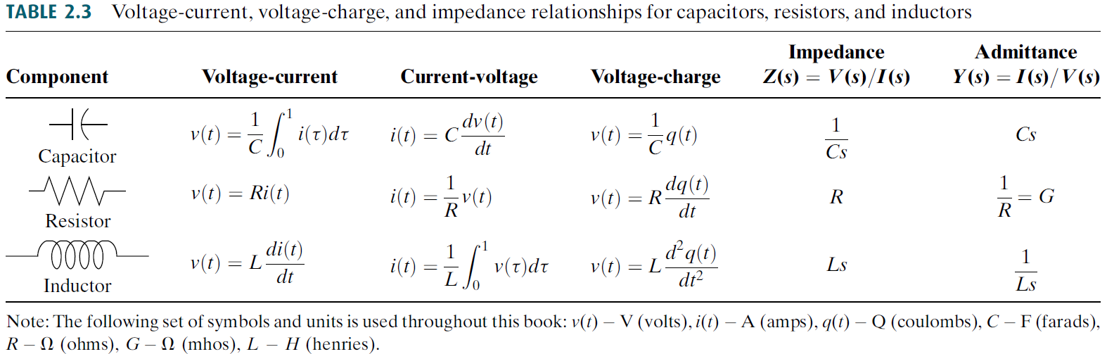

Translational Mechanical System Transfer Functions
$$v\left(t\right)=\frac{ⅆx\left(t\right)}{ⅆt}$$
$$x\left(t\right)=\int_{0}^{t}{v\left(t\right)ⅆt}$$
$$f\left(t\right)=Kx\left(t\right)$$
$$Dv\left(t\right)$$
$$D$$
$$a\left(t\right)=\frac{ⅆv\left(t\right)}{ⅆt}$$
$$f\left(t\right)=Ma$$

Slide 9
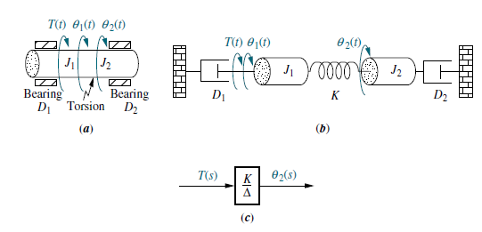
Example 2.19

Slide 10

Example 2.20

Slide 11
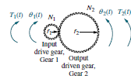
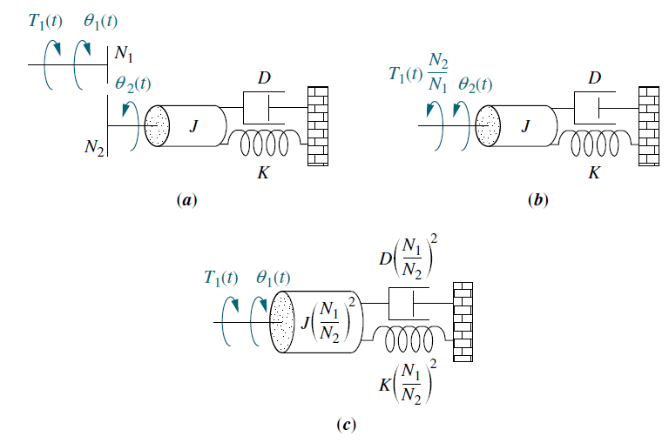




Gears

Slide 12
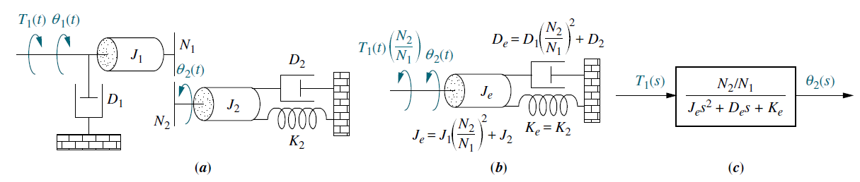
Example 2.21

Slide 13
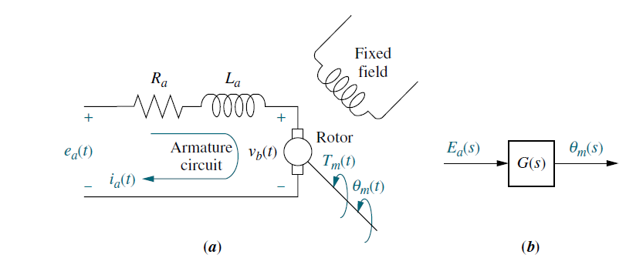
Electromechanical System Transfer Functions
DYI

Slide 14
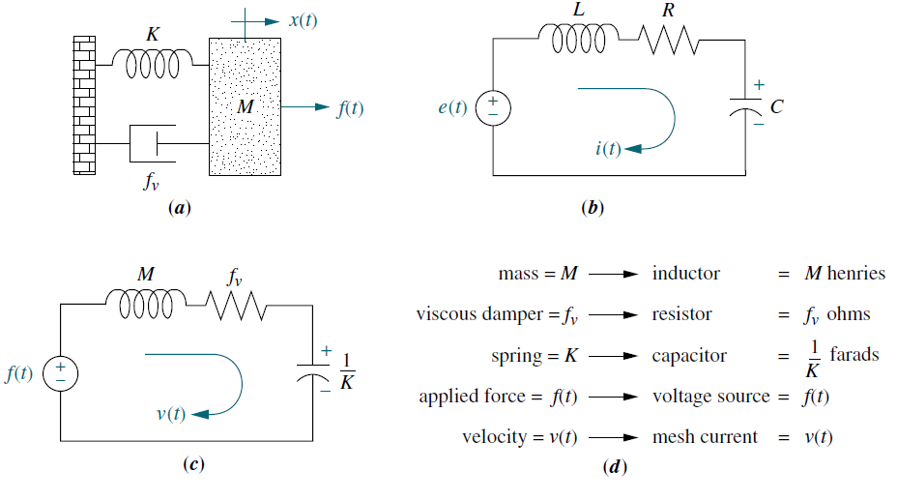
Series Analog
Start defining displacement for each mass

Slide 15
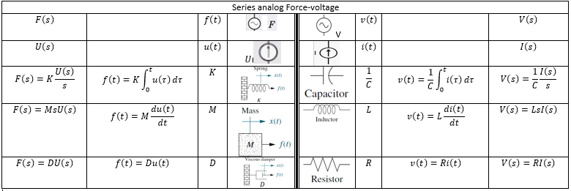
Series Analog Comparison

Slide 16
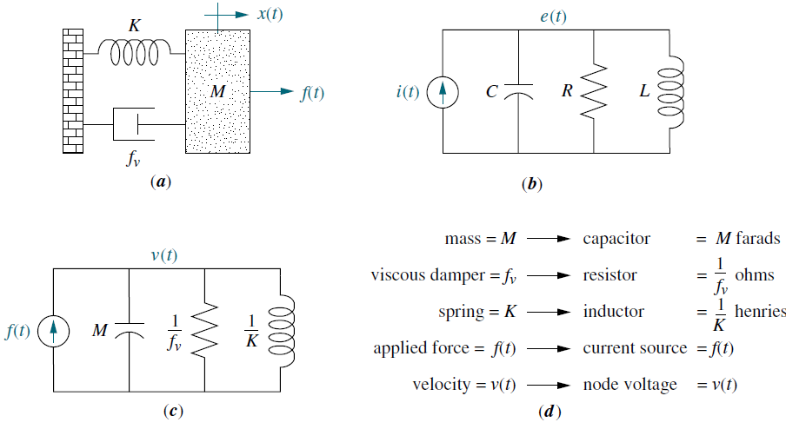
Parallel Analog
Start defining displacement for each mass

Slide 17
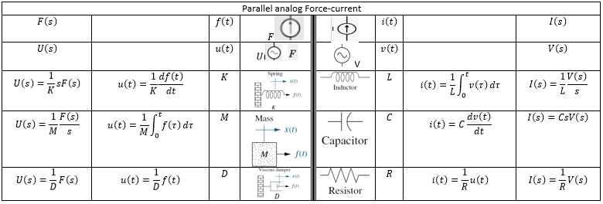
Parallel Analog Comparison

